Slide 1
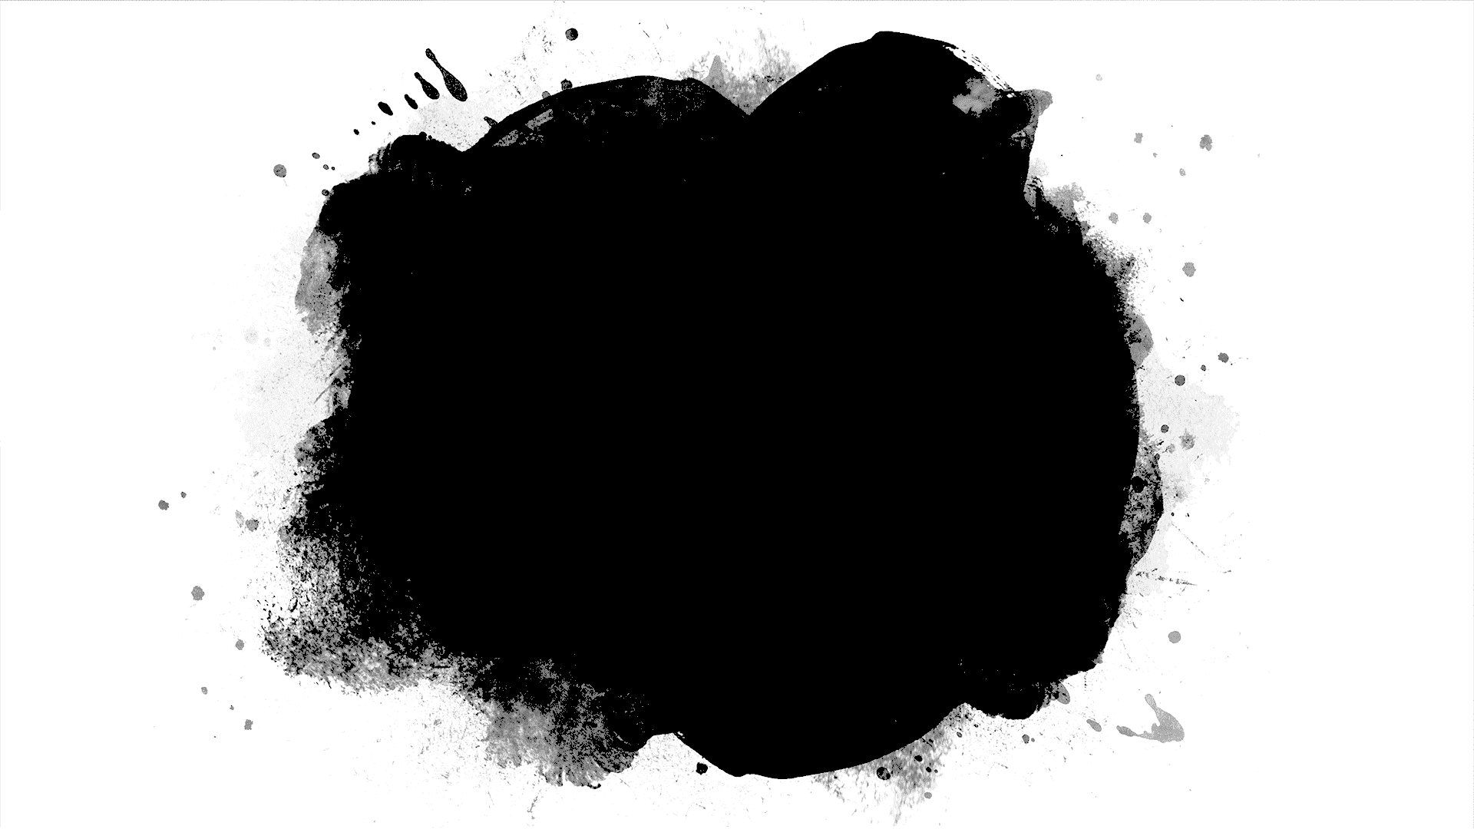
DriverPass System Analysis
[Your Name]
Notes:
[No speaker notes required for this slide.]

Slide 2
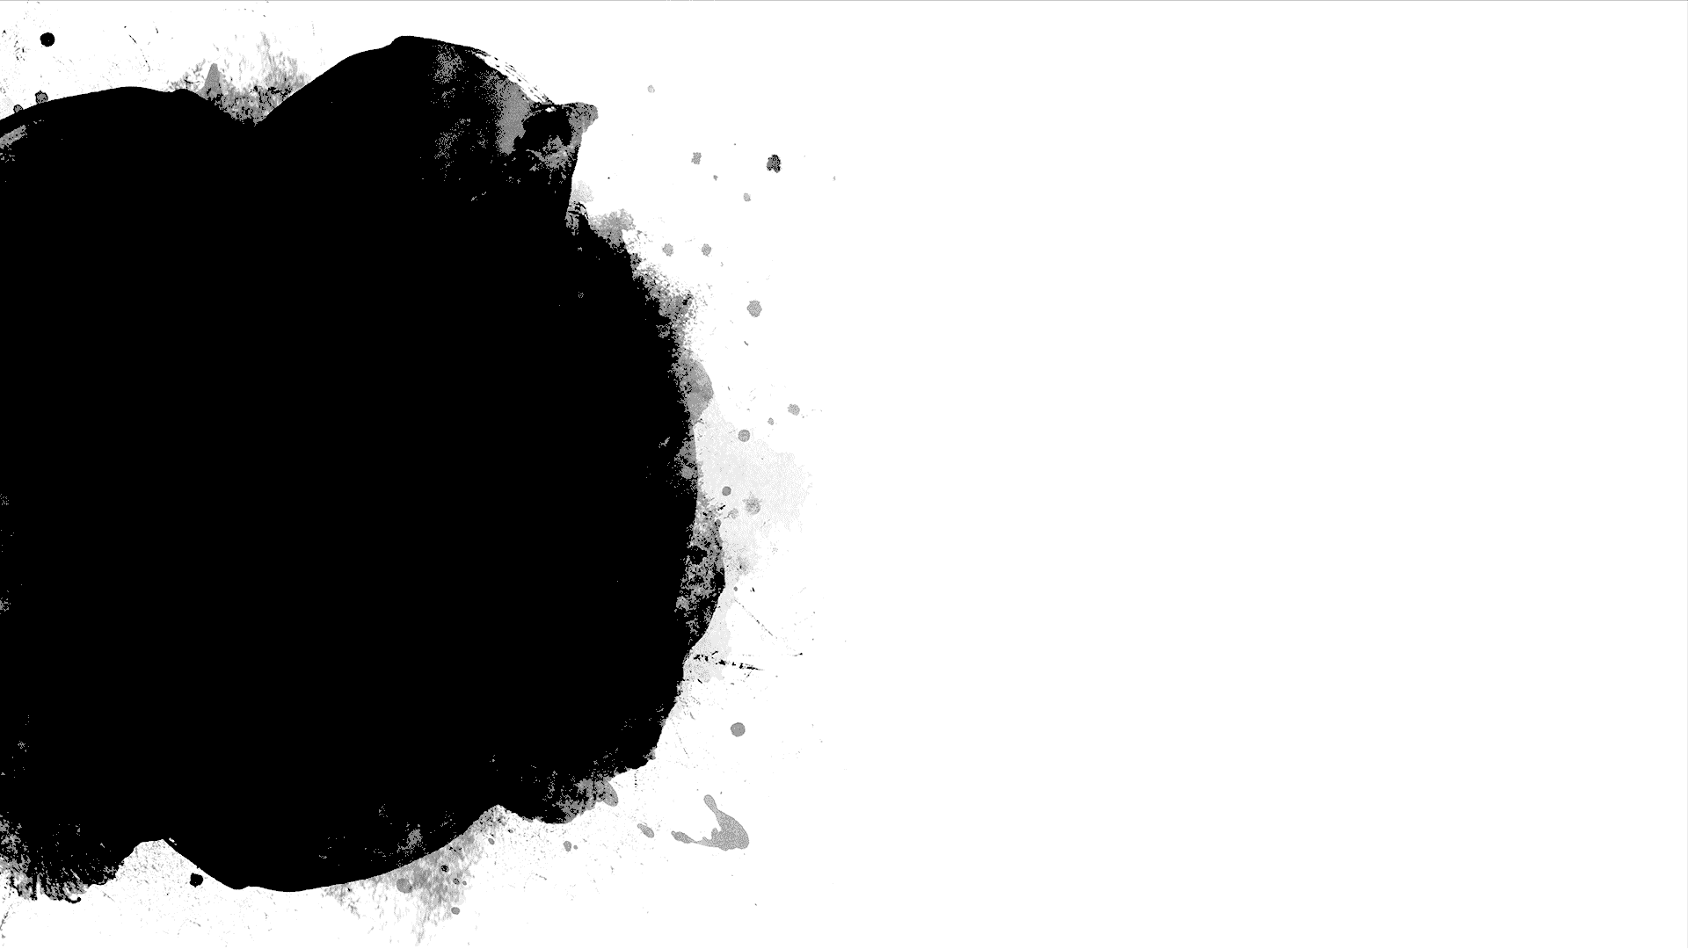
System Requirements
Functional requirements:
The system shall validate users’ credentials when logging in to identify the user type
The system will allow users to set up and modify appointments, take testing, and track their progress within the system
Nonfunctional requirements:
The system should use the cloud for its data base, and features to eliminate the client from having to update/maintain the system and data base.
It should run on linux servers, using a client-server pattern
Notes:
The function requirements I selected to describe are validating user credentials when logging in based on the user type, and allowing user to schedule/modify appointments, take testing and track progress via the system being designed. The requirements are crucial for the clients vision of the driver pass system, validating user credentials is important for security measures, and also because the client wants to have multiple types of users within the system. Allowing the user to schedule, modify and track appointments via the driver pass system is the clients vision of helping their customers pass their driving test.
The non-functional requirements that I have selected talk about the system will be cloud based and run on linux servers. The system being cloud based will help meet the request from the client that system be easy to maintain and require minimal technical support from the client themselves in order to focus on business. The system running on linux servers will be cost efficient and very strong for being a web-based app as the client wants to be cross platform but does not want to develop for platform specific hardware.

Slide 3
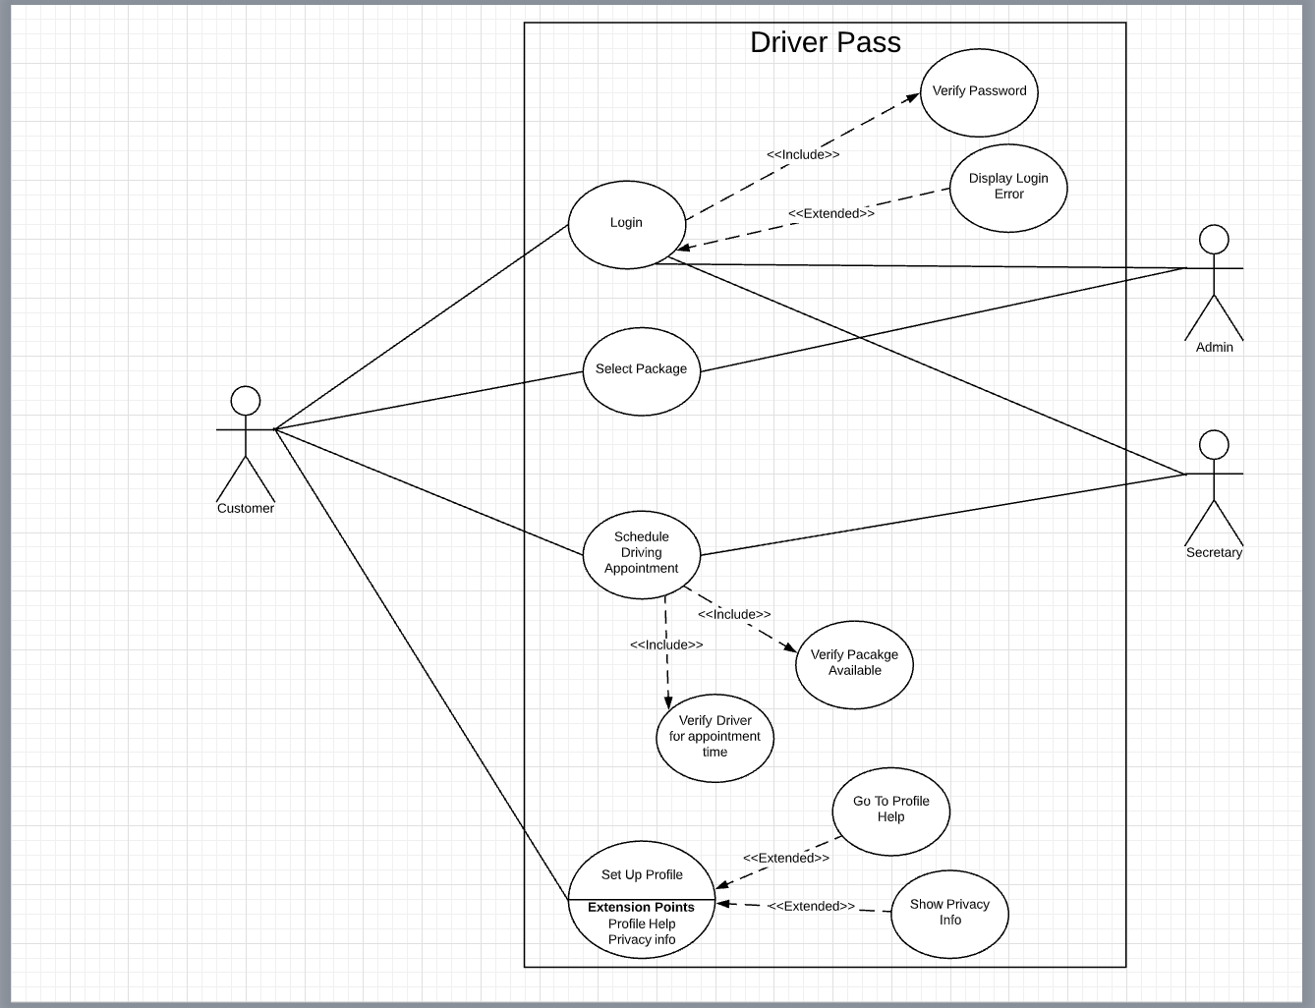
Use Case Diagram
Notes:
Looking at the diagram here we are describing how a customer, the admin and secretary will interact with the driver pass system. The customer will be the primary user of the system, and initiate by logging in and being verified, if login is not valid the user will be required to attempt login again. The customer will also interact with the system by purchasing a package and scheduling appointments. We also have the admin who will manage the packages, appointments, and login attempts for reporting and tracking purposes. A secretary will also interact with the system by scheduling appointments for customers.

Slide 4
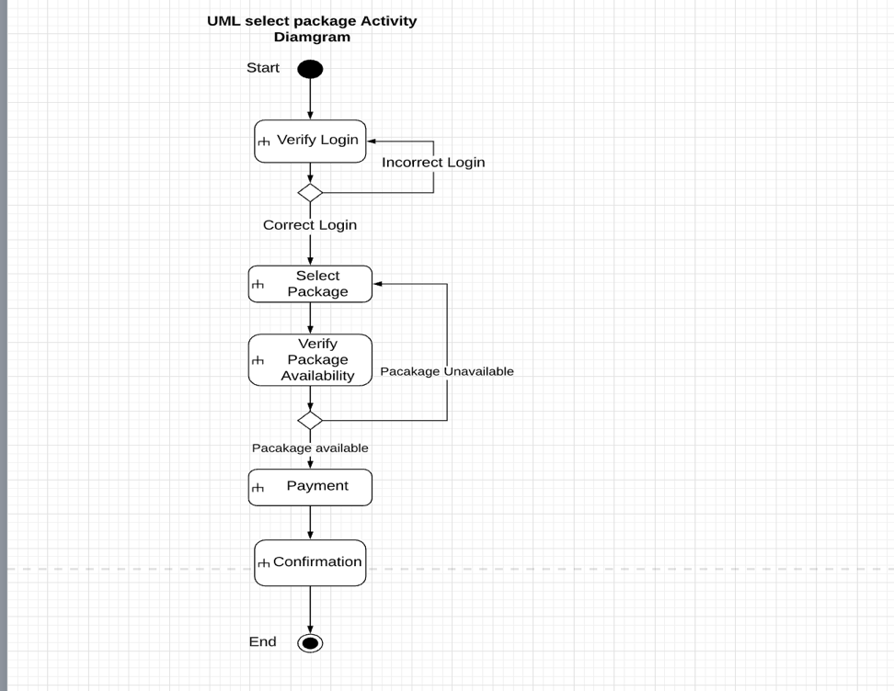
Activity Diagram
Notes:
We want to break down the process of allowing the user to select a package within the driver pass system. This diagram outlines the process from start which requires the user to first login, then select their desired package, the package will then need to verified as available if not the user will have to select another package. This is because the admin will be unable to remove packages in the first build of the system. If the package is not available the customer will be required to select another package. Once a package is confirm the user will be required to pay for the package in order to access the content. This is one of the major asks from the client in order to meet their vision of helping the customer pass their driving test.

Slide 5
Security
Upon set up the customer type user info required for a log in should be name, date of birth, address, email and phone number.
Personalized username and password, with the ability to block duplicates.
Security questions for password/username recovery
Password should be case sensitive and require a minimum of 8 characters with 1 special character and 1 number.
Secondary authentication methods such as 2-factor authentication shall be used
The server should limit login attempts to 3 to prevent brute force hacking
The user should be able to automatically reset their password by verifying security information
Notes:
In consider security for my design, I thought about some of the most widely used practices like two-factor authentication, encryption methods for payments, and passwords and etc. Also allowing the user to reset their password w/ having two factor authentication will eliminate having to do administration resets. Having the server lock the account after three attempts of login will help prevent issues like Ddos, and other brute force hacking methods out there.

Slide 6
System Limitations
Some limitations will be budget since this is a smaller style business
Certain modifications will not be able to be made without changing code
The system will only be web based at launch
The project will have a limited time frame for development
Weekly updates could be costly for the client
Notes:
Some system limitations will be that the system is only accessible via the web, customers will not be downloading apps on their mobile phones to access to the driver pass system. It will mostly require the user to be at desktop/laptop for full compatibility. Since the business is just starting out their budget is very small, and will not allow for high end development strategies. The time frame for development will not allow for certain functionality that the client requested.

